Slide 1
Statistical Distribution Theory
Standard Discrete and Continuous Distributions

Slide 2
Contents
01
02
What is Data Distribution?
Discrete vs Continuous Distributions
03
04
Bernoulli and Binomial Distribution
Poisson Distribution
05
06
Exponential Distribution
Normal and Lognormal Distributions

Slide 3
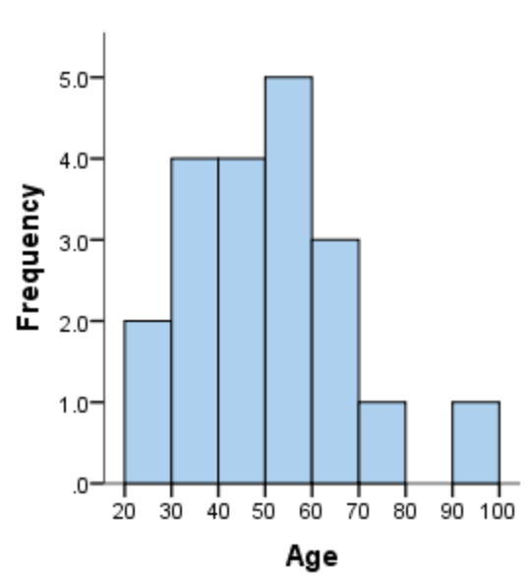
What is a Data Distribution?
A data distribution describes how values of a variable are spread or arranged across its possible range. It reveals the frequency or probability of different outcomes occurring and provides a complete picture of the data's behavior.
Distributions can be represented through multiple formats:
Frequency tables showing counts or proportions
Histograms displaying visual patterns
Mathematical functions (PDF for continuous, PMF for discrete variables)
Real-World Examples: Exam scores often follow a bell-shaped normal distribution, with most students scoring near the average. Manufacturing defects per batch typically follow a Poisson distribution, modeling rare random events.

Slide 4
Discrete vs Continuous Distributions
Understanding the distinction between discrete and continuous distributions is fundamental to choosing appropriate statistical methods and interpreting results correctly.
Feature
Discrete Distribution
Continuous Distribution
Type of Data
Countable outcomes (integers)
Uncountable outcomes (any real value)
Function Type
Probability Mass Function (PMF)
Probability Density Function (PDF)
Single Value Probability
P(X = x) > 0
P(X = x) = 0 (only intervals have probability)
Common Examples
Number of insurance claims, coin tosses
Height, weight, time measurements
Graphical Display
Bar graph (separated bars)
Smooth curve

Slide 5
Bernoulli Distribution
The Foundation of Binary Outcomes
The Bernoulli distribution represents the simplest random experiment: a single trial with exactly two possible outcomes. We conventionally label these as success (1) or failure (0), though these terms don't imply positive or negative results.
Probability Mass Function
Key Parameters
Mean:= p
where x =0,1
Variance:= p(1 - p)
Practical Applications: Policy renewal decisions (renewed or not), patient treatment response (positive or negative), quality control checks (pass or fail), customer conversion (purchase or no purchase).

Slide 6


Binomial Distribution
Counting Successes in Repeated Trials
The binomial distribution extends the Bernoulli concept to n independent trials, each with the same probability p of success. It answers the question: "How many successes will occur in n attempts?"
Mathematical Definition
Distribution Properties
Mean: μ = np
Variance: σ² = np(1 − p)
for k = 0, 1, 2, ..., n
Standard Deviation: σ = √(np(1 − p))
Insurance Example: If 1,000 insured vehicles each have a 3% probability of filing an accident claim, the number of claims follows a binomial distribution with n = 1000 and p = 0.03, giving an expected 30 claims.

Slide 7
Poisson Distribution
Modeling Rare Events Over Time or Space
The Poisson distribution describes the number of events occurring in a fixed interval when these events happen independently at a constant average rate λ (lambda). It's particularly useful for modeling rare occurrences.
Probability Mass Function
Unique Property
Mean = Variance = λ
This equality is a distinctive characteristic that helps identify Poisson processes in real data.
for k = 0, 1, 2, 3, …
Common Applications in Practice
Number of insurance claims per month per 1,000 policies
Number of accidents at a traffic intersection per week
Manufacturing defects in a production batch

Slide 8
Exponential Distribution
Time Between Events
While the Poisson distribution counts how many events occur, the exponential distribution models how long we wait between events in a Poisson process. It's the continuous counterpart focused on timing rather than counting.
Probability Density Function
Distribution Characteristics
f(x) = λe−λx for x > 0
Mean: μ = 1/λ
Cumulative Distribution Function
Variance: σ² = 1/λ²
F(x) = 1 − e−λx
Standard Deviation: σ = 1/λ
This gives the probability that the waiting time is at most x units.
Memoryless Property: P(X > s + t | X > s) = P(X > t)
This remarkable property means the distribution "forgets" how long you've already waited. If a device hasn't failed after running for s hours, the probability it survives another t hours is the same as if it were brand new.
Applications: Time until next insurance claim, equipment lifespan modeling, customer service wait times, radioactive decay
intervals.

Slide 9
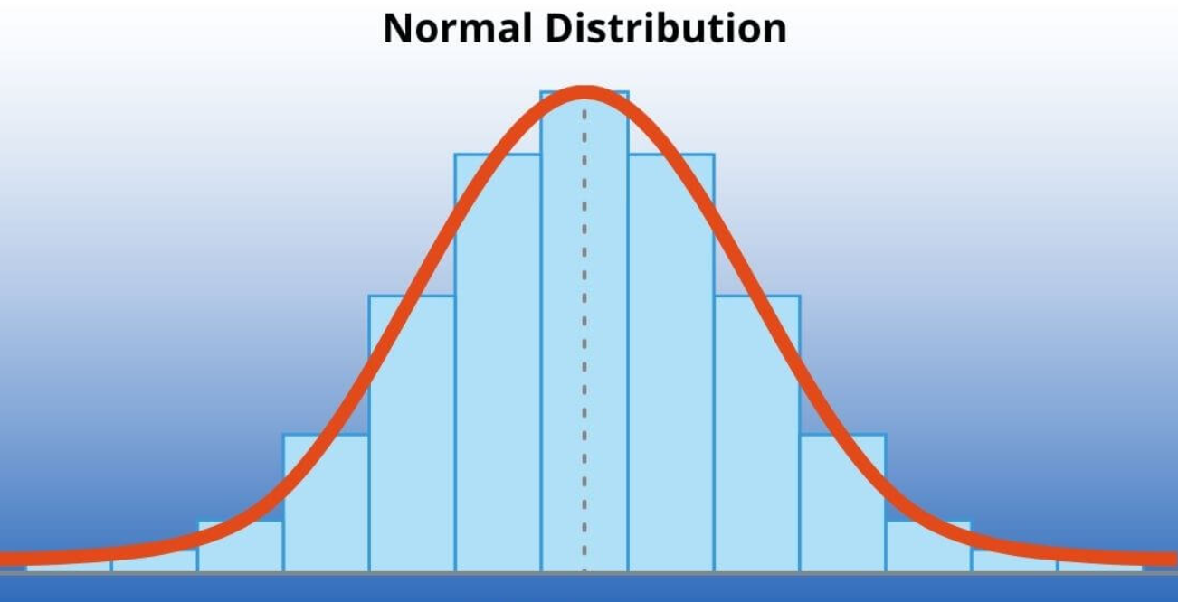

Normal Distribution
The Bell Curve That Rules Statistics
The normal distribution, also called the Gaussian distribution, is the most important probability distribution in statistics. Its symmetric, bell-shaped curve appears throughout nature and human behavior, making it fundamental to statistical inference.
Key Properties
Probability Density Function
Symmetric around the mean
Mean = Median = Mode at center
The Normal variable can take real values from minus infinity to plus infinity
Defined by two parameters: mean μ and standard deviation σ

Slide 10
Normal Distribution
The Bell Curve That Rules Statistics
Why the Normal Distribution Matters:
The Central Limit Theorem states that for a large number of independent random variables, the distribution of their averages tends toward a normal distribution, regardless of the original population distribution. This property makes the normal distribution the foundation for hypothesis testing and confidence interval estimation.
For example:
If we take the average height of 500 randomly selected people, the distribution of these sample means will be approximately
normal, even if individual heights are not perfectly normal. (think of taking a random sample of size 500 repeatedly giving
Sampling distribution of sample mean)

Slide 11
Understanding the 68-95-99.7 Rule
The Empirical Rule for Normal Distributions
01
02
03
One Standard Deviation (±1σ)
Two Standard Deviations (±2σ)
Three Standard Deviations (±3σ)
Approximately 68% of data falls within one standard deviation of the mean. This captures the bulk of typical values.
Approximately 95% of data falls within two standard deviations. Values outside this range are considered unusual.
Approximately 99.7% of data falls within three standard deviations. Values beyond this are rare outliers.
Range: μ − σ to μ + σ
Range: μ − 2σ to μ + 2σ
Range: μ − 3σ to μ + 3σ
Practical Application: If exam scores are normally distributed with mean 75 and standard deviation 10, then 68% of students score between 65 and 85, while 95% score between 55 and 95. Only about 0.3% score below 45 or above 105.

Slide 12
Log-Normal Distribution
When the Logarithm is Normal
A random variable X follows a log-normal distribution if its natural logarithm ln(X) is normally distributed. This distribution is always positive and right-skewed, making it ideal for modeling variables that can't be negative and have a long tail of high values.
Income Distributions
Stock Prices
Insurance Claim Amounts
Most people earn moderate incomes, but a small number earn extremely high incomes, creating a characteristic right-skewed pattern.
Prices can grow exponentially but cannot fall below zero, making log-normal distributions appropriate for financial modeling.
Most claims are small, but catastrophic claims create a long right tail that is well-captured by the log-normal distribution.

Slide 13
Quantile-Quantile Plot
A Powerful Graphical Tool for Assessing Normality
The Quantile-Quantile (Q-Q) plot is a very powerful graphical method of assessing whether data follows a normal distribution. It provides visual evidence that complements formal statistical tests.
01
02
Calculate Sample Quantiles
Determine Theoretical Quantiles
Quantiles are calculated using your sample data and ranked in order from smallest to largest.
Expected quantiles are calculated based on what we would expect if the data truly came from a normal distribution.
03
04
Plot and Compare
Assess Linearity
Sample quantiles (Y-axis) are plotted against theoretical quantiles (X-axis). If the data is truly normal, the plot will be linear.
High correlation between sample and theoretical quantiles indicates the normality assumption is valid for your data.

Slide 14
Interpreting Q-Q Plots
Reading the Visual Evidence
The Q-Q plot displays actual quantile values from your sample on the Y-axis and theoretical values expected under a normal distribution on the X-axis. The pattern reveals whether your data follows a normal distribution.
Linear Pattern
Curved Pattern
Points fall close to a straight diagonal line, indicating the data distribution closely matches the normal distribution. This is strong evidence for normality.
Points deviate systematically from the line in a curved pattern, suggesting the data is skewed (either left or right) and not normally distributed.
S-Shaped Pattern
Outliers
Points form an S-curve, indicating the data has heavier or lighter tails than the normal distribution (kurtosis issues).
Individual points far from the line at the extremes indicate outliers that deviate from the normal distribution pattern.

Slide 15
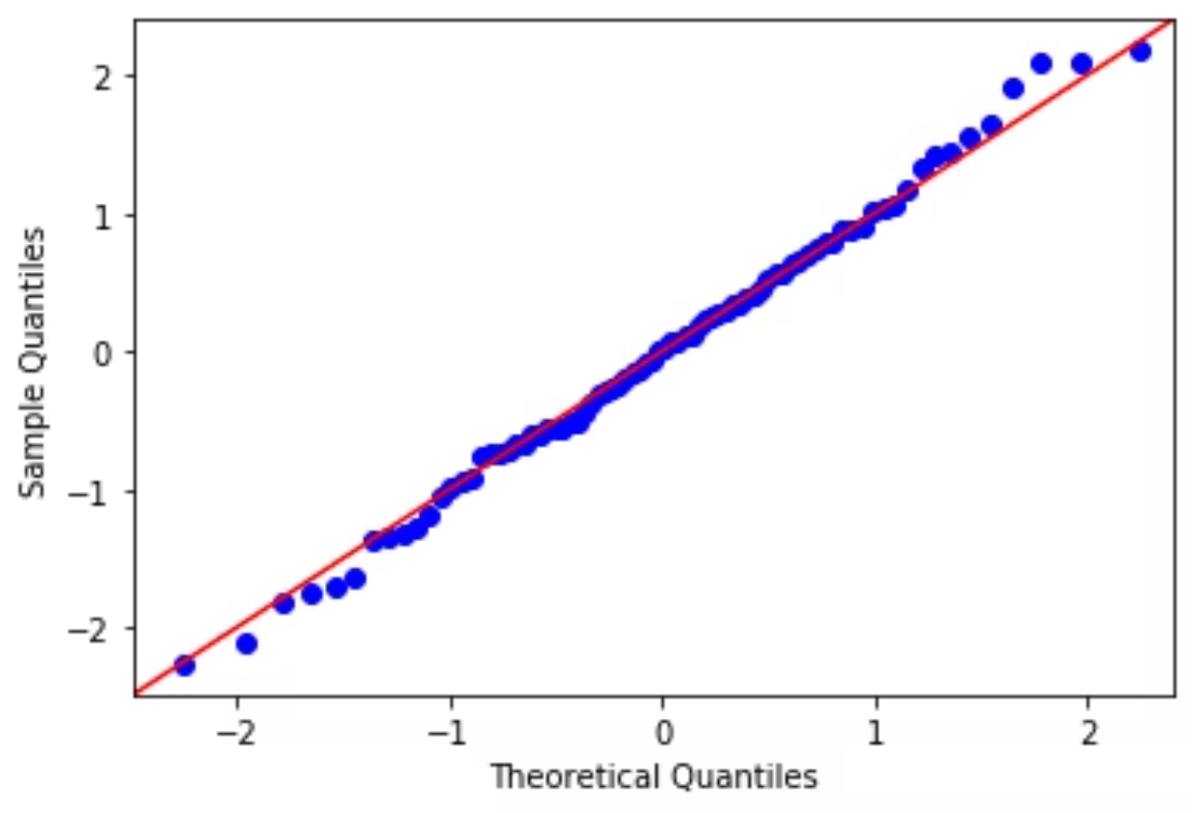
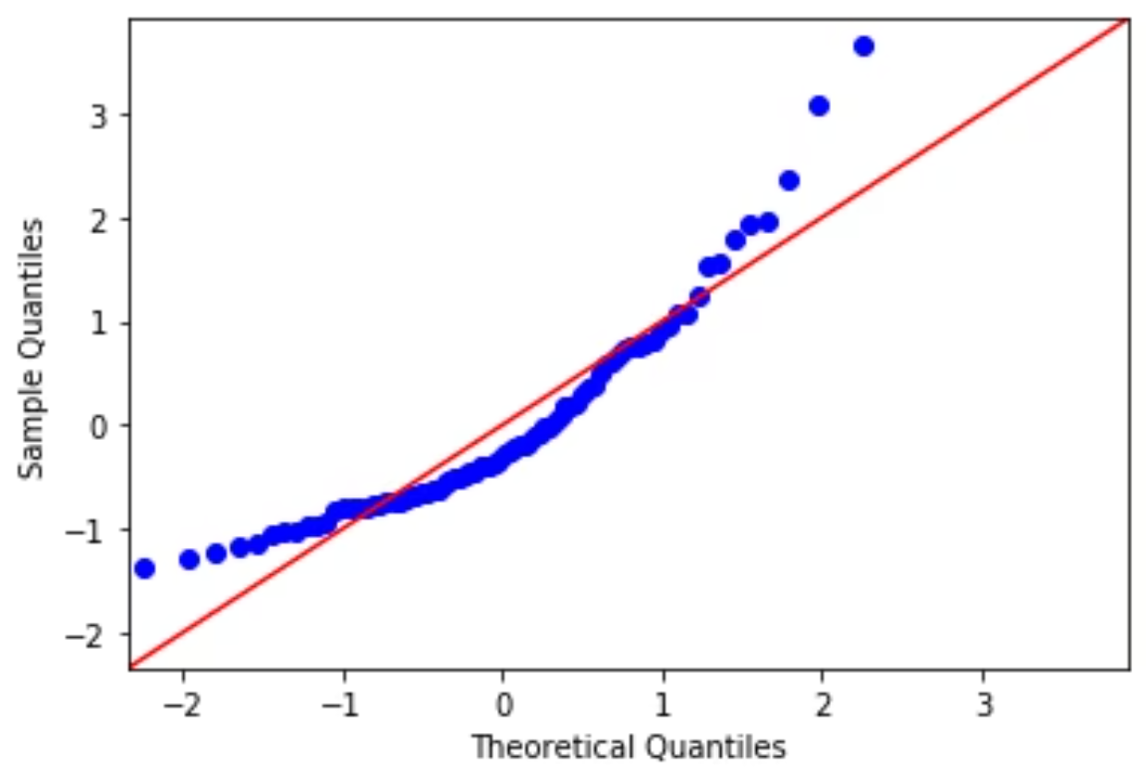
Q-Q Plot Examples
Assessing Normality in Practice
Example 1: Normal Data
Example 2: Non-Normal Data
Interpretation: Q-Q plot is linear. The distribution can be assumed to be normal. Points closely follow the diagonal reference line.
Interpretation: Q-Q plot is deviated from linearity. Distribution of 'billamt' appears to be non-normal. Systematic departure from the line suggests skewness.
These visual assessments are essential for determining whether parametric statistical tests (which assume normality)
are appropriate for your data analysis.

Slide 16




Key Takeaways
Essential Concepts in Distribution Theory
Distribution Fundamentals
Key Discrete Distributions
Distributions describe how data spreads across possible values. Discrete distributions use PMFs; continuous distributions use PDFs. Each type serves different data structures.
Bernoulli for single binary trials, Binomial for counting successes in n trials, Poisson for rare events with constant rate.
Key Continuous Distributions
Visual Assessment Tools
Exponential for time between events, Normal for symmetric data, Log-Normal for positive skewed data like income or prices.
Use Q-Q plots to test normality assumptions. These graphics are essential for proper statistical analysis and model validation.

